Slide 1
IMMUNOPATHOLOGY Dr. Kaduyu Dennis
1, BASIC CONCEPTS OF IMMUNITY AND IMMUNE RESPONSE
2, IMMUNITY AND IMMUNISATION
3, DISEASES CAUSED BY DEFECTIVE OR INNAPROPRIATE IMMUNE RESPONSES

Slide 2
IMMUNITY AND IMMUNISATION
DEFINITIONS
IMMUNIZING AGENTS
TYPES OF IMMUNISATIONS
EXPANDED PROGRAMME OF IMMUNISATION (EPI)

Slide 3
DEFINITIONS
IMMUNISATION
Is the process of inducing immunity by either vaccination (active immunization) OR administration of antibody (passive immunization).
VACCINATION
Is the administration of a vaccine or toxoid(inactivated toxin) for prevention of disease.
Clinical aspect
When a vaccine against a disease is given the vaccine, it acts in place of a natural antigen and stimulates the body to start producing appropriate immunity in 7-10 days .

Slide 4
IMMUNIZING AGENTS
Immunizing agents are substances or organisms that provoke an immune response when introduced in the body.
Examples include
vaccines ,Toxoids ,Antiserum
Vaccines and Toxoid
cause the body to produce their own antibodies bringing about active immunity
Antiserum-produces passive immunity.

Slide 5
VACCINES
These contain either live attenuated(weakened) or killed microorganisms such as viruses, bacteria .
Live attenuated vaccines
These are manufactured from live bacteria/viruses that have been reduced in strength or virulence so as they do not cause severe infection or disease.
Examples; BCG,POLIO,MEASLES,RABIES ,YELLOW FEVER VACCINES
Dead vaccines
These are made up of dead/killed bacteria or viruses and cannot cause diseases,but the antigens can stimulate antibody production /immunity.
Examples ; Pertusis-dead bacteria
Hep B vaccine-made from surface coating of killed hepatitis B virus

Slide 6
TOXOIDS
These are made by modifying toxins produced by some bacteria, modified toxins that have been changed enough not to cause disease but they can stimulate immunity
Examples, Tetanus toxoid, Diphtheria, Tetanus part in DPT.
ANTISERUM
Antiserum are preparations of blood serum that already contain an antibody or Antibodies .
They are used when there is not time to wait for the body of the exposed or infected person to produce its antibodies.
Examples , Ant-tetanus immunoglobulin(tetanus antitoxin),hepatitis B immunoglobulin(HBIG), Human rabies immunoglobulin .

Slide 7
TYPES OF IMMUNISATION
ACTIVE IMMUNISATION
This involves stimulating the immune system to produce antibodies and cellular immune responses that protect against the infectious agent.
I.E It involves administration of Toxoid, all or part of weakened micro-organism or a modified part of that microorganism to evoke an immunological reaction that mimics that of a natural infection but usually presents little or no risk to the recipient.

Slide 8
PASSIVE IMMUNISATION
This provides temporary protection through administration of exogenously produced antibody such as immunoglobulin
Passive immunization also occurs naturally through transplacental transmission of antibodies to a fetus.
Clinical aspect
Passive immunization may be also utilized in the following;
During epidemics
Tetanus antitoxin, Measles ,Rabies, varicella zoster
Kids on chemotherapy
Immunocompromised individuals
Hepatitis B immunoglobulin to a baby born to hepatitis B seropositive mothers

Slide 9
EPI: Expanded Programme of Immunization
Following success of smallpox vaccination, in 1974 WHO launched a series of country-based programmes entitled EPI.
The objective was to reduce disease incidence and death rate in early childhood from six major preventable infections: diphtheria, whooping cough, neonatal tetanus, poliomyelitis, tuberculosis and measles.
Recently, Pneumococcal ,Rotavirus(2016) ,hepatitis B(2002) , haemophilus influenza type b were added.
Clinical aspect –which year?

Slide 10
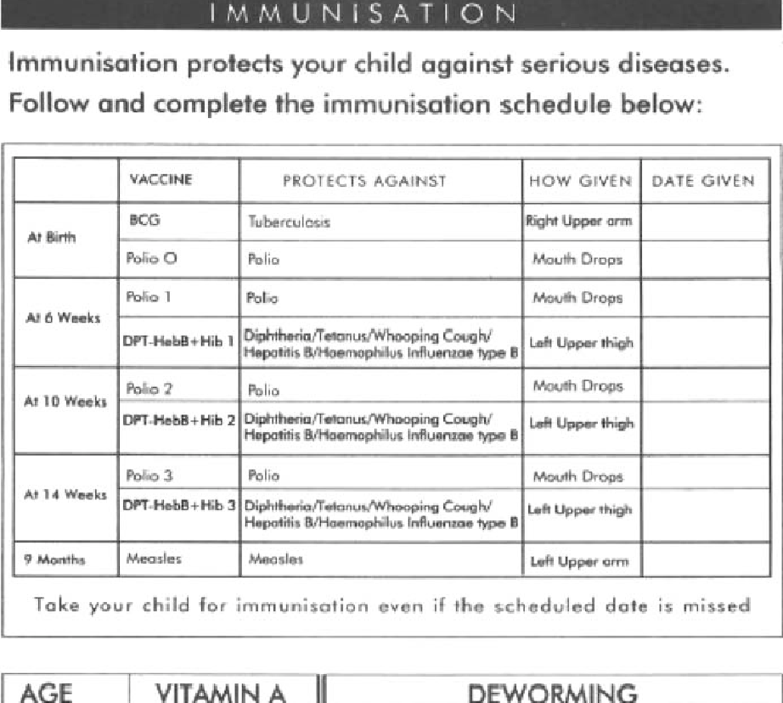
Immunisation schedule

Slide 11
EPI: other child health interventions
Vitamin A supplementation
De-worming
Growth monitoring

Slide 12
Vaccine storage
Frozen- Measles, OPV, -20 º C
Not frozen; DPT, Hib, Hep B, BCG at +2 to +8 º C

Slide 13
TT to mother during pregnancy
Passive immunization from mother provides effective, important and quick protection against tetanus in the newborn.
TT administration during pregnancy helps mothers to quickly develop antibodies to protect their newborns.

Slide 14
Live vaccines
Provide active immunization, usually with good protection after one dose of each kind of vaccine.
BCG & measles – given only once for adequate protection, although booster doses may be required for measles.
Polio vaccine actually contains 3 different types or strains of the polio virus. Need to give more than once so that each strain gets several opportunities to stimulate antibody production.
The different doses should be at least one month apart.

Slide 15
Dead vaccines
DPT-Heb-Hip is thus given 3 times to provide adequate protection.
Doses must be spaced at least 1 month apart
The 2nd and 3rd doses stimulate antibody mechanism to quickly produce even higher levels of antibodies than before.
Spacing also gives time for the body to produce the antibodies and to recover from possible reactions to previous vaccination before receiving another

Slide 16
Effects of maternal antibodies
An important consideration on when /at what time to vaccinate babies depends on whether the baby still has antibodies from the mother or not.
Vaccines should not be given to a baby who still has maternal antibodies because the antibodies will inactivate the vaccine before it can stimulate immunity.
A waste of vaccines
Gives false assurance to mother that her baby is protected

Slide 17
Effects of maternal antibodies
Length of time maternal antibodies remain in baby’s blood varies for different diseases.
Antibodies against BCG do not cross over to the baby; therefore BCG can safely be given at birth.
Antibodies against polio, diphtheria, pertusis and tetanus do cross over to baby if mother has had these diseases or was immunized against them. However, they remain for only a few weeks; so the vaccines can safely begin at 1 month of age.

Slide 18
Effects of maternal antibodies
Measles antibodies remain longest in the newborn, usually up to 9 months of age.
Measles vaccine thus has the best effect if given after 9 months.
In measles prone areas or during measles epidemics, children between 6 and 9 months are at greater risk of getting measles. Vaccine can be given at 6 months and a booster dose administered at 9 months of age.

Slide 19
CLINICAL ASPPECT
Tetanus ( pregnant mothers in course of pregnancy)
Answer –At first contact or early as possible in pregnancy (TT1)
Atleast 4 weeks after TT1
Atleast 6 months after TT2 Preferrably btn 27woa and 36woa
Yellow fever
According to CDC(Centre for Disease Control)
For most people a single dose of yellow fever vaccine provides long lasting protection and a booster dose is not needed HOWEVER people travelling to or leaving in areas of risk for yellow fever (Africa,South America),may consider getting a booster dose if it has been 10yrs or more since they last vaccinated.

Slide 20
HEPATITIS B VACCINE
For people not immunized during childhood immunization
Give Hepatitis b vaccine at 0 months,4weeks and 6 months booster after 1 year from last dose.
For people who miss their vaccine after one month they have to repeat the entire vaccination .
For people immunized during childhood immunization (from 2002) according to WHO
1, Studies have shown that infants who have responded to a 3 dose hepatitis B immunization series are protected from the disease for as long as 15 years.long term protection on immunological memory which is protective after exposure to HBV booster doses of vaccine are not recommended.
2,For children born to mothers with Hepatitis B they receive hepatitis b immunoglobulin within 24hrs then continue with the routine during immunization at 6weeks ,10weeks and 14 weeks.

Slide 21
RABIES
Pre-Exposure (Especially for people dealing with animals )
On day1,day7 and day 21
Post –Exposure(after dog /cat /animal bite`unvaccinated)
On day 1,day3,day7 and day 14
N.B After dog bite/Cat bite and the patient comes after 7 days of treatment he/she receives 2 doses at ago meant for day 1 and day 3 preferably on different arms then continues on day 7 and day 14.
Measles
For children above 6months and there happens to be an out break they receive the tetanus immunoglobulin then again get at 9 months.

Slide 22
IMMUNISATION SCHEDULE
For babies who miss polio o for 2 weeks no need to give just give polio 1 at 6 weeks .
For babies who miss the scheduled vaccine they get on first contact then get what they should have to received after one month.

Slide 23
ASSIGNMENT
Dosage ,method of administration ,site of administration ,side effects and adverse effects of vaccines .

